Slide 1

INTERNET PROGRAMMING AND MOBILE PROGRAMMING

Slide 2
Market Management System

Slide 3
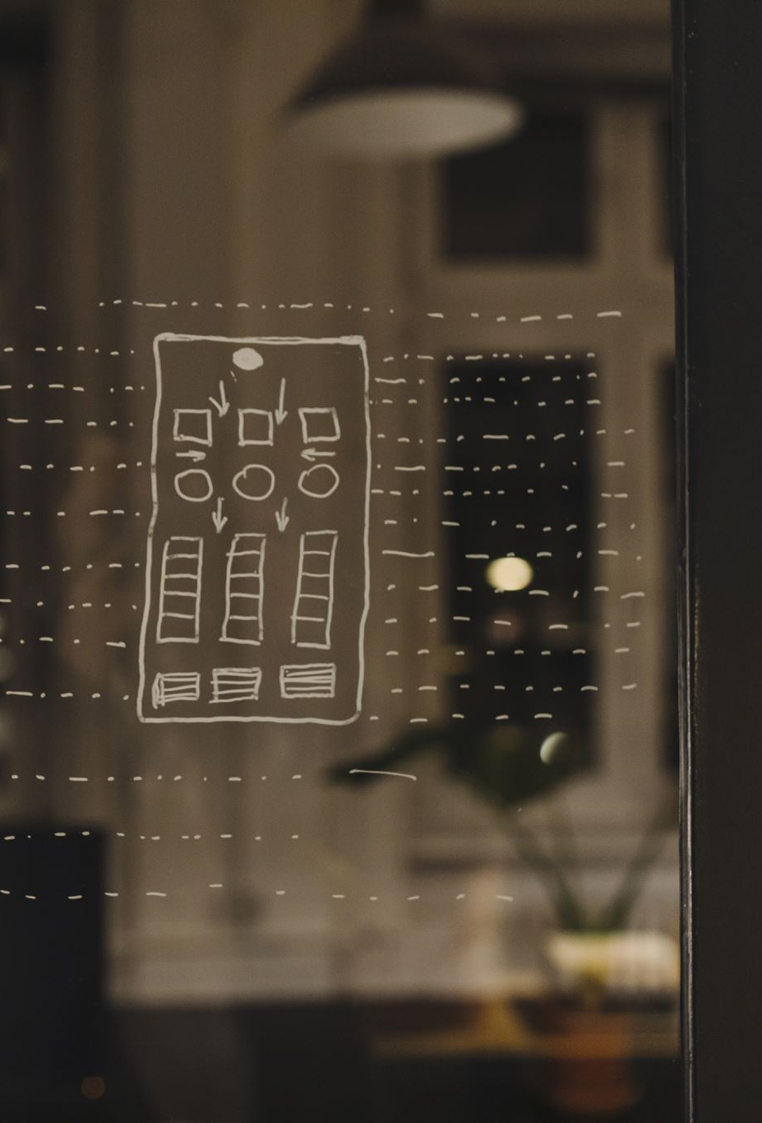
Table of contents
Introduction
UI/UX design
Introduction
Customer side
Vendor side
Interaction Design
Usability, Testing and Evaluation
Implementation of the design
Vendor side
Customer side

Slide 4

UI/UX design
INTERNET AND MOBILE PROGRAMMING

Slide 5
Introduction
The purpose of this UI/UX Design and Implementation Report is to provide a comprehensive overview of the design and development process for the Market Management System, with a focus on creating an exceptional user experience (UX) through an intuitive and visually appealing user interface (UI).

Slide 6
Visual Design
UI/UX Design for Customer:

Slide 7
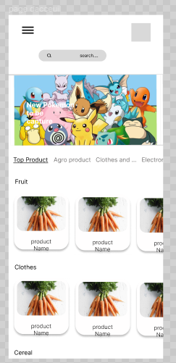
Visual Design
Here the Customer views all the products which are already in category

Slide 8
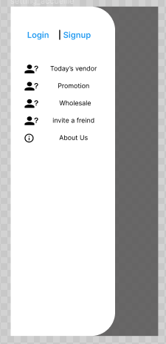
Visual Design
Here the Vendor has the choice to login if he already has an account or sign-up so as to create an account

Slide 9
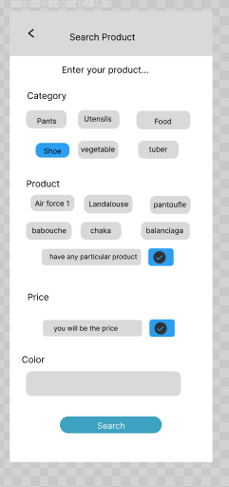
Visual Design
The Customer is able to search a product based on the category

Slide 10
Visual Design
Below we can see that there is a first part concerning the preview where the customer can view a product and products similar to it, also he is able to view details about the product like Vendor, prices and quantity, location and product name.

Slide 11
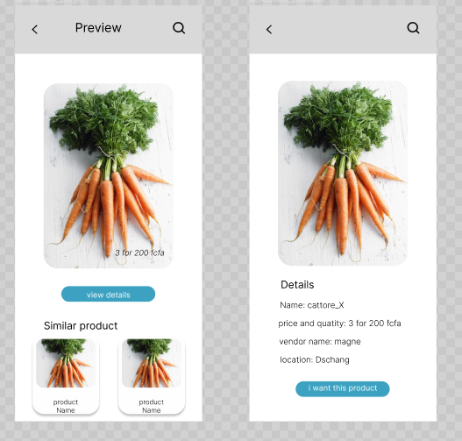
Visual Design

Slide 12
Visual Design
UI/UX Design for Vendor:

Slide 13
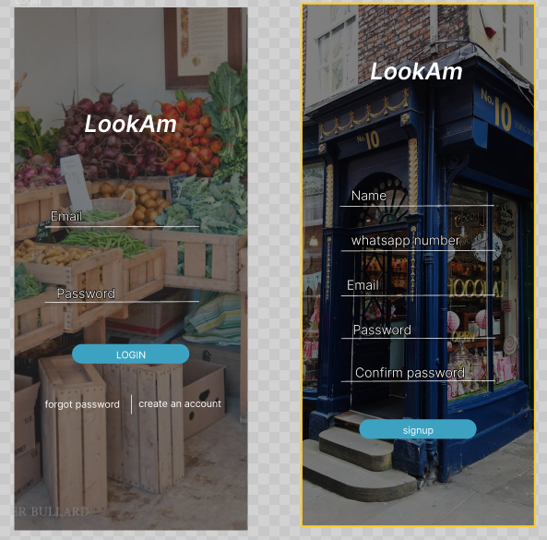
Visual Design

Slide 14
Visual Design
The Vendor can Sign-up or Login. In case the Vendor has forgotten his or her password there is a Two way authentication so as to check if the Vendor exists in the System, and it’s design is as follows,

Slide 15
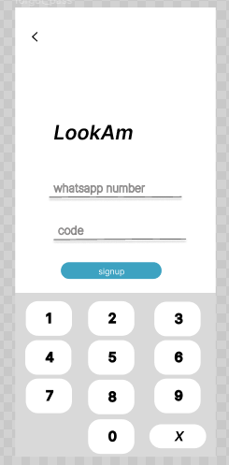
Visual Design

Slide 16
Visual Design
The following Screen is the setting Screen which has several functionalities such as Account; for a Vendor to view his or her account.
Confidentiality,
Notification,
App Language,
Help; so as to get help from the system or the individual behind the System,
Invite a contact

Slide 17
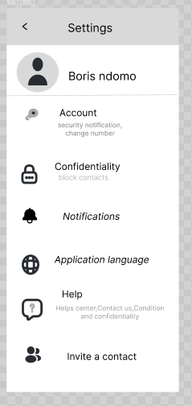
Visual Design

Slide 18
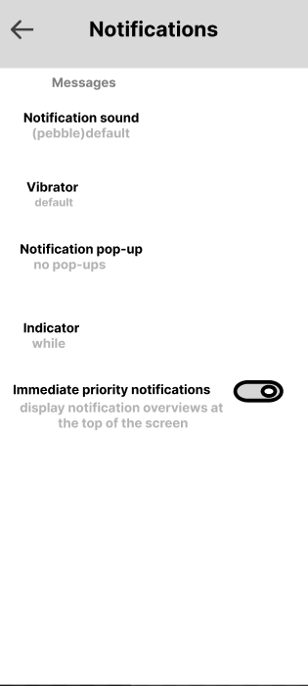
Visual Design

Slide 19
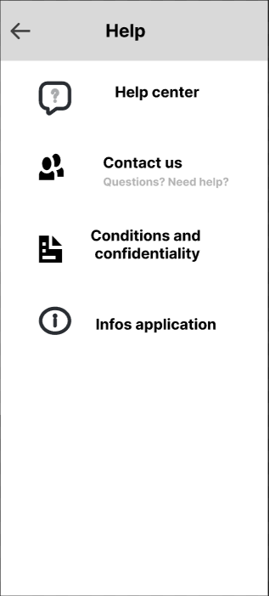
Visual Design

Slide 20
Visual Design
The Vendor is able to Add a product, select the category for his or her product and set a price for the product

Slide 21
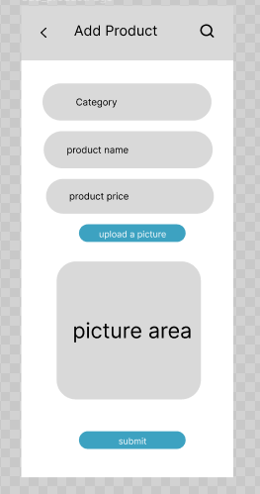
Visual Design

Slide 22
Visual Design
The Vendor is also able of Modifying and Deleting a Product, and the System Displays Notifications as we can see below

Slide 23
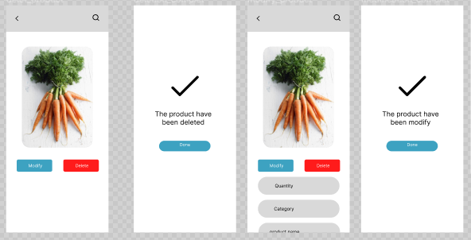
Visual Design

Slide 24
Interaction Design
Interaction design played a vital role in creating a seamless and intuitive user experience within the Market Management System. User flows, task scenarios, and user journeys were meticulously crafted to guide market managers through their tasks efficiently. Interactive elements, such as buttons, forms, and data input methods, were designed to provide instant feedback, reducing errors and enhancing user confidence.

Slide 25
Usability, Testing and Evaluation
Usability testing sessions were conducted to evaluate the effectiveness and efficiency of the UI/UX design. Real market managers were given specific tasks to complete within the system, and their interactions were observed and analyzed. User feedback and quantitative data were collected to identify pain points and areas for improvement. The iterative testing and evaluation process ensured that design decisions were based on user needs and preferences.

Slide 26

Implementation

Slide 27
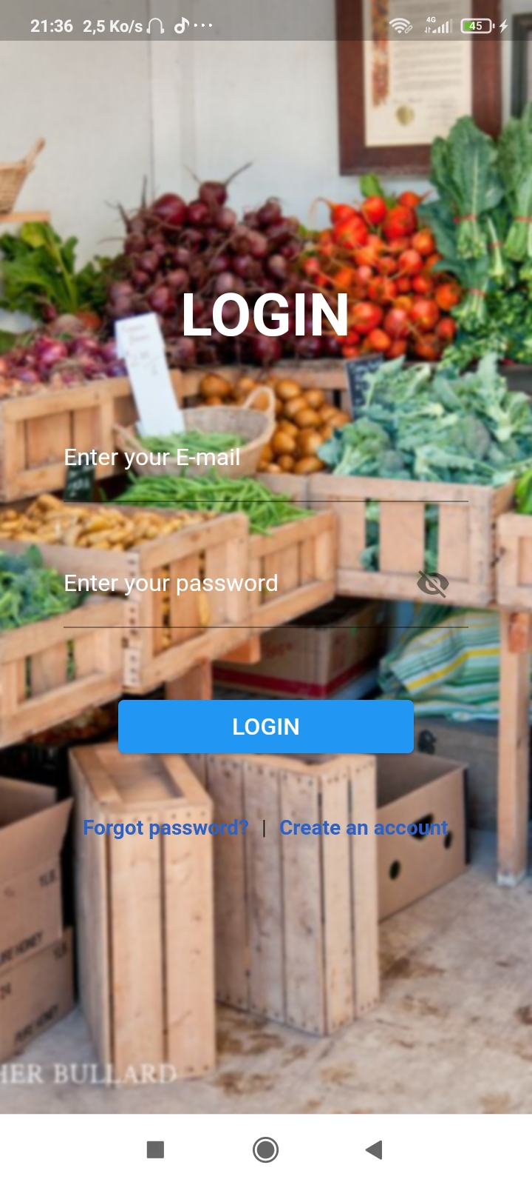
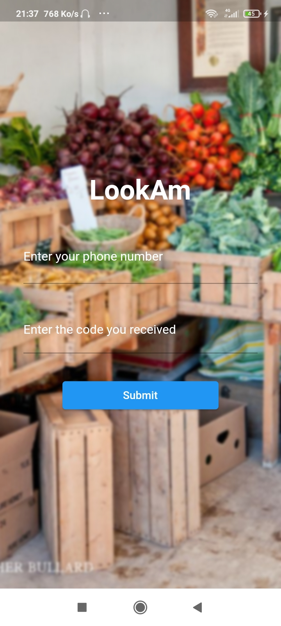
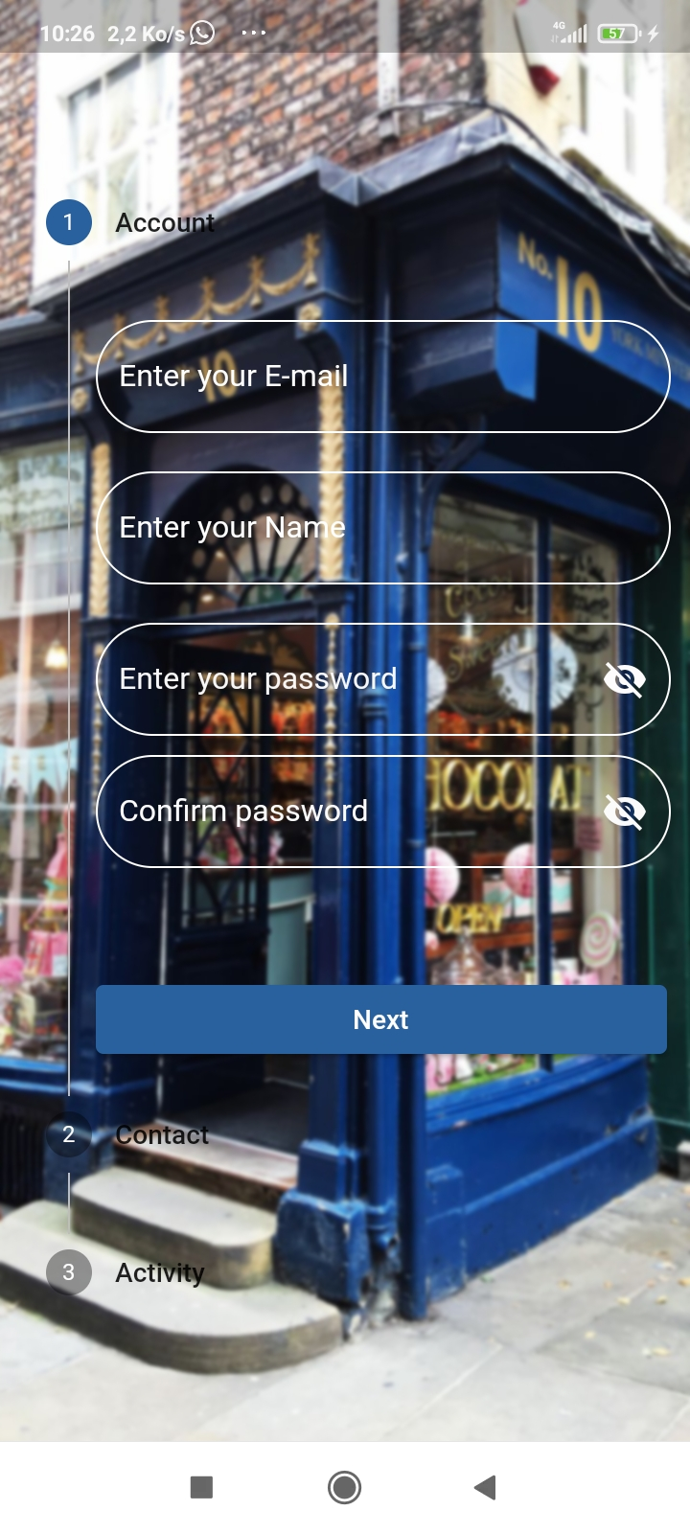
implementation
Vendor side

Slide 28
Implementation
Vendor side
Contains the Login, Sign-Up, Forget password page which make use of forms to better control the text input that are being sent to us. Also to better control the validity of the inputs that are sent to us; we make use of REGEX.

Slide 29
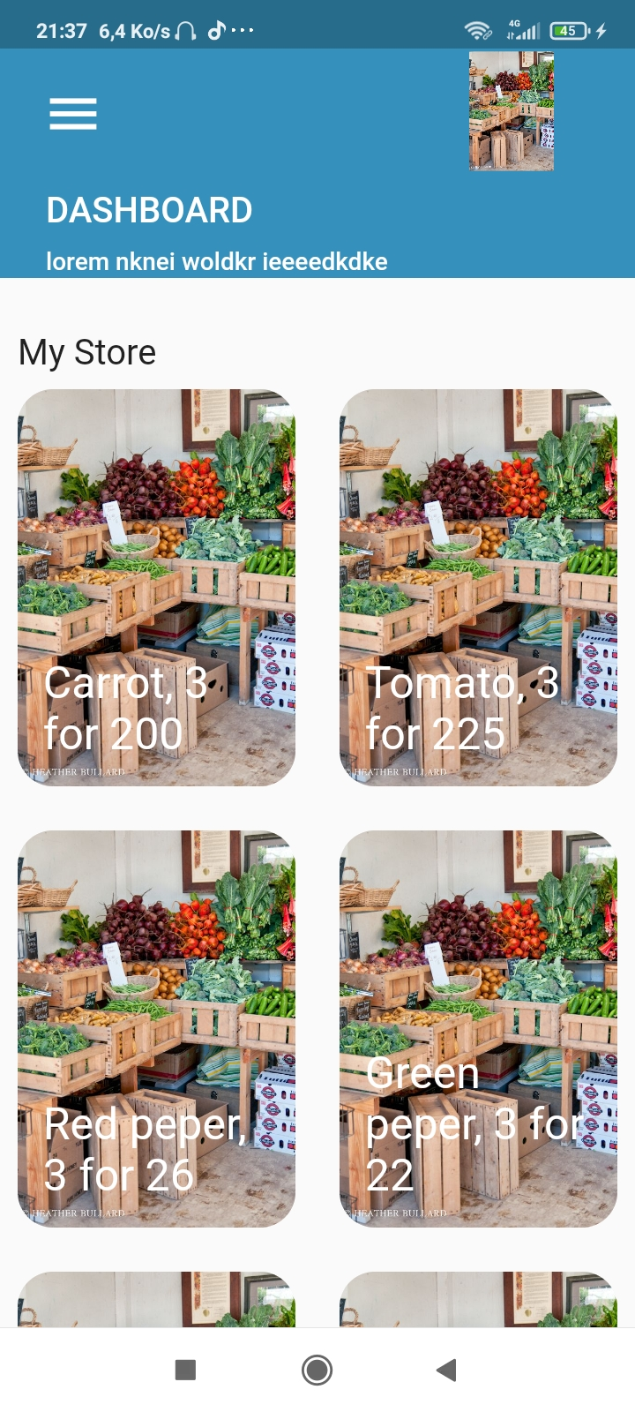
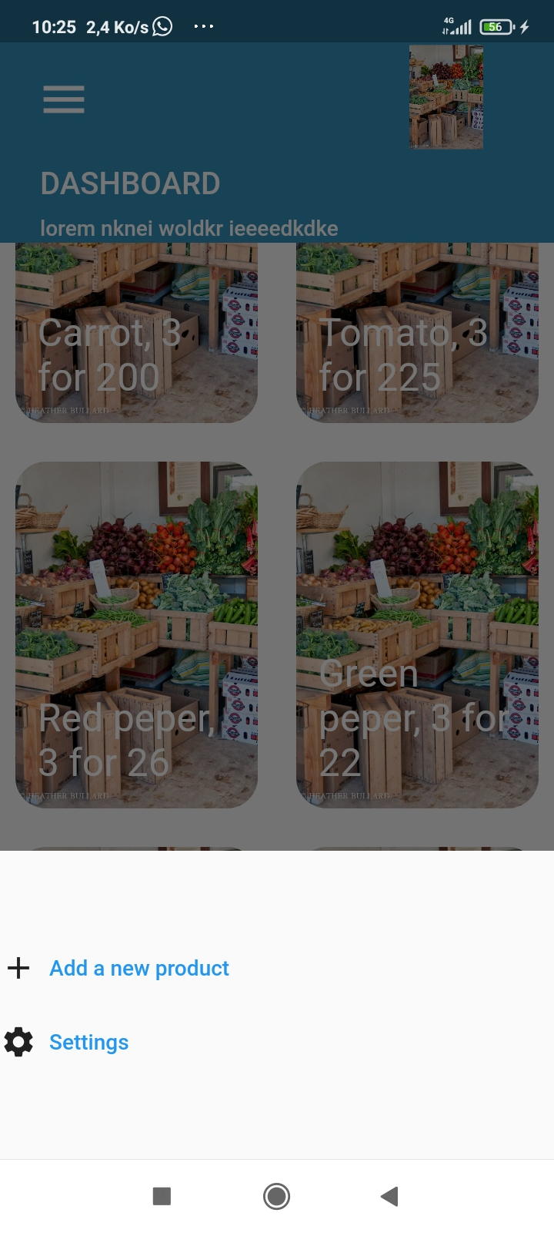
implementation
Vendor side

Slide 30
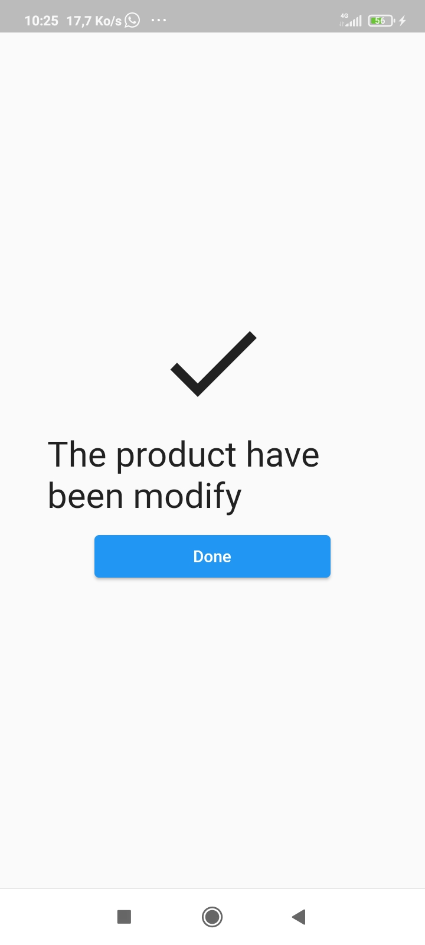
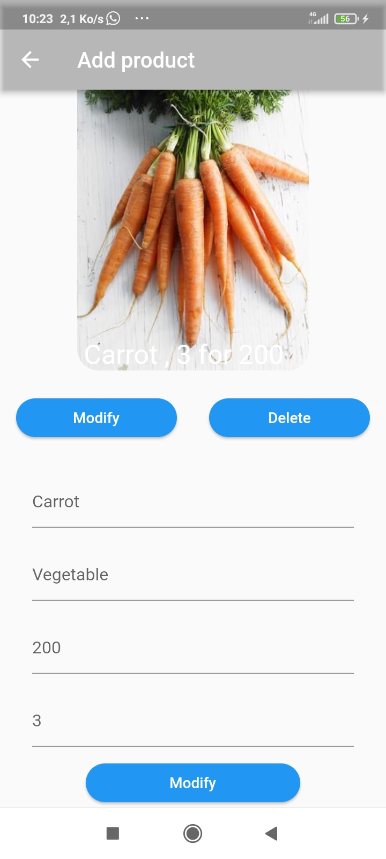
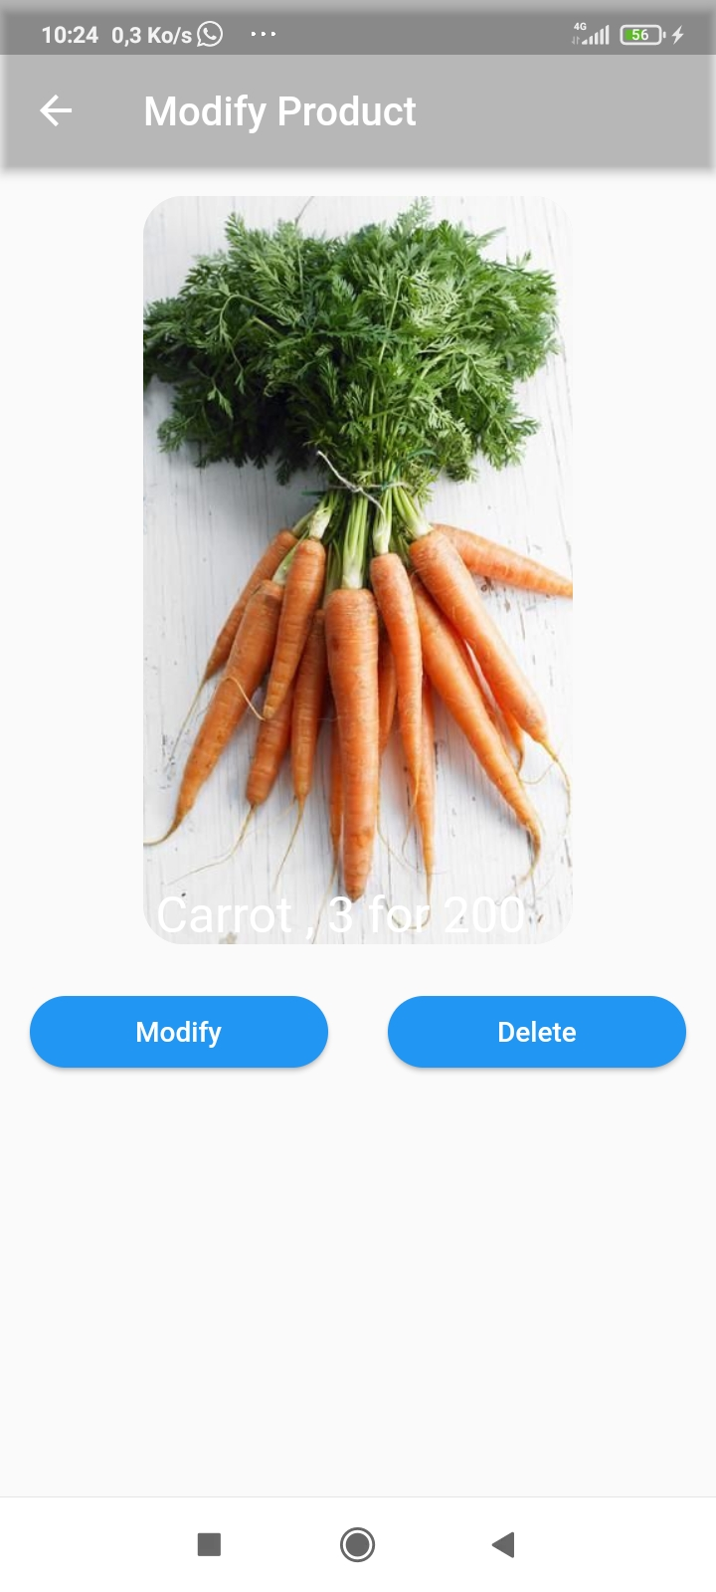
implementation
Vendor side

Slide 31
implementation
Vendor side
The Vendor can modify or delete a product by clicking on the modify where a form will be displayed below and by clicking on the delete button the product is being deleted directly

Slide 32
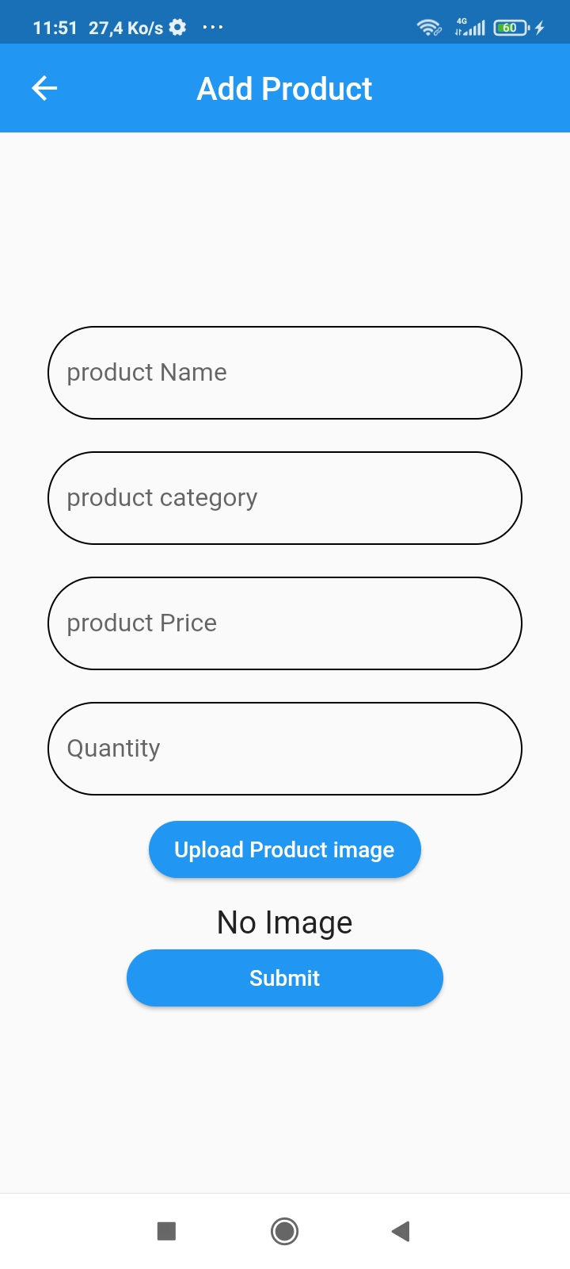
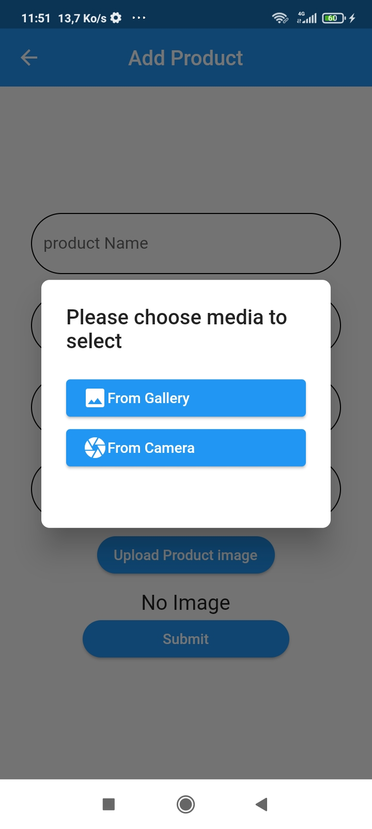
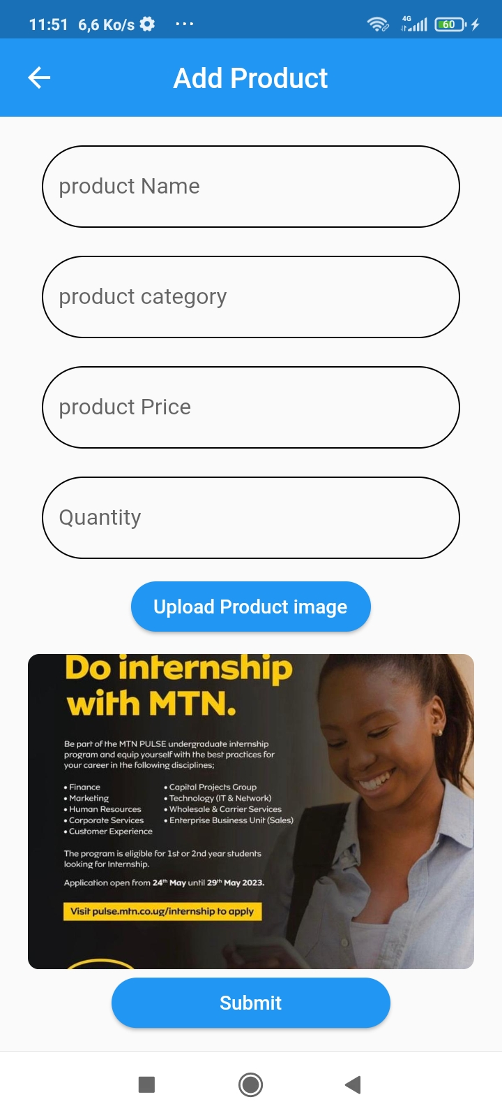
implementation
vendor

Slide 33

implementation
Customer

Slide 34
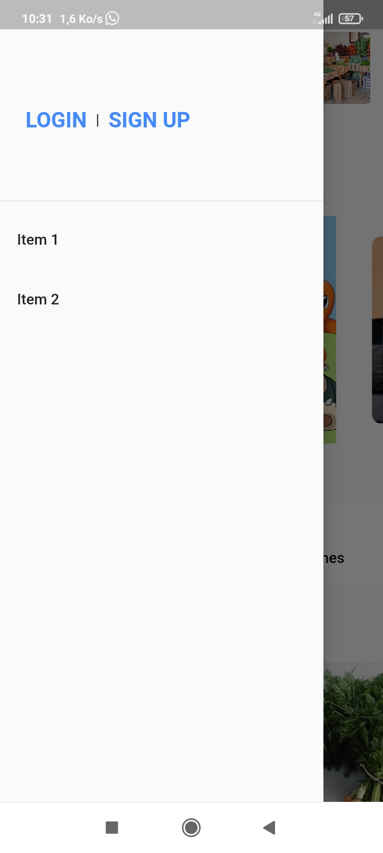
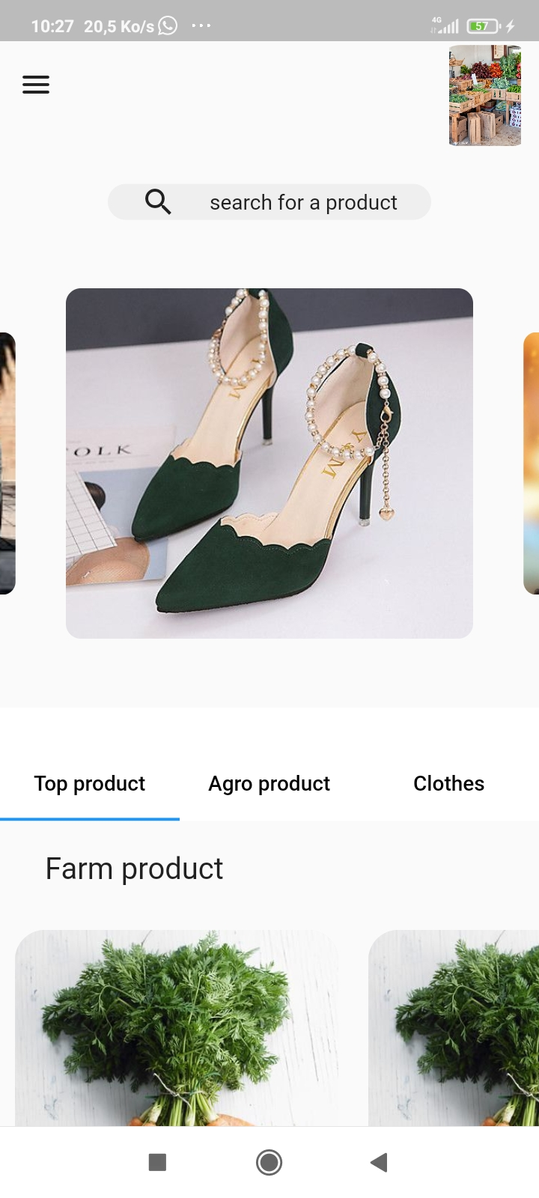
implementation
Customer side

Slide 35
Thank you

